Slide 1
The Consumer Tech Conundrum

Slide 2
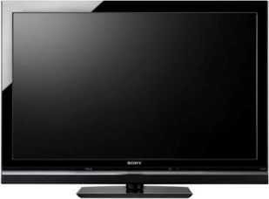
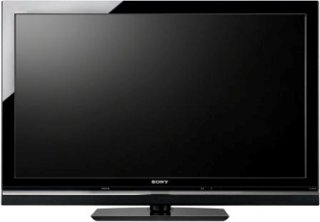
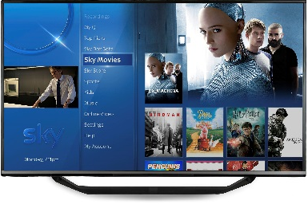
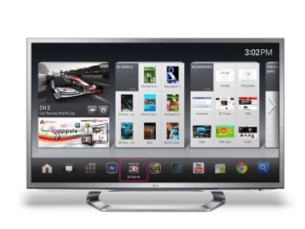
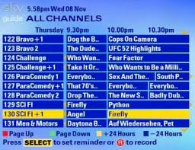
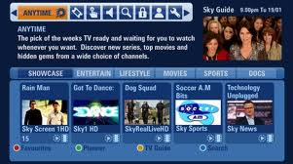
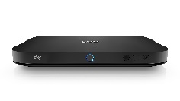
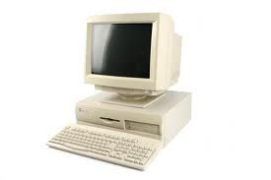
The Five Stages Of TV
Simple TV
Multi-Channel
Multi-Function
Connected & Converged
Cloud

Slide 3
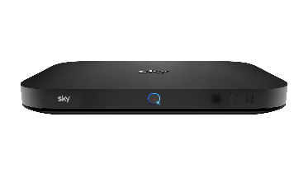
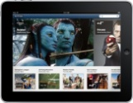
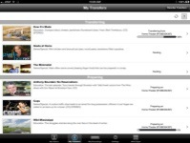
The Future - The New Connected Home
‘Media Server’ PVR
12 Tuners
2TB Local Storage
10TB PVR
UV Library
INTERNET
Network PVR and ‘owned media’ store
PVR
VOD
Live
Channels
Smart TV
The Operator’s Platform App
Dumb TV
The Operator’s ‘Puck’
Device / Apps
The Operator’s Mobile App
Notes:
3

Slide 4
The TV Conundrum
Why do we still need set top boxes?
Federated TV players vs managed systems?
Who should deliver TV to smart devices – broadcaster or platform?
Can broadcast players survive in the face of platform competition?
Does On-Demand trump PVR or vice versa?
How does data fit into the TV world?

Slide 5
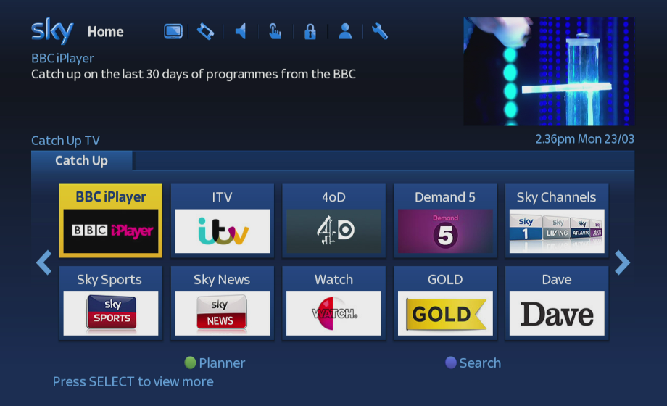
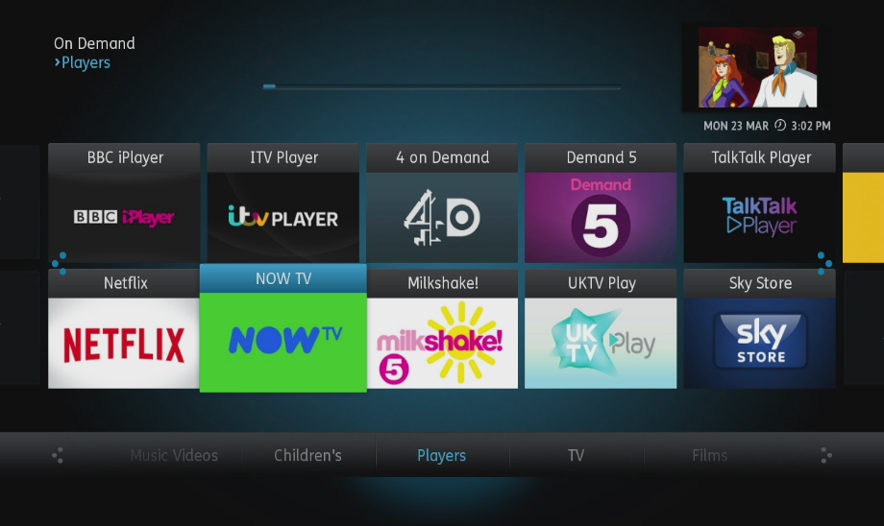
Platform VOD vs Federated Player VOD

Slide 6
Functionality Intertwined With Data?
Connected & Converged
Simple TV
Multi-Channel
Multi-Function
Cloud
Colour Broadcast
Remote Controls
Pay Broadcast
Simple EPGs
HD Broadcast
Red Button / MHEG
Rich media TV EPGs
PVRs
Device VOD (Broadcaster)
TV VOD (Platform)
4k Broadcast / linear IP
Red Button 2 / IP
HTML EPGs On All Devices
nPVRs & Media Mgmt
Device VOD (Platform)
Personalised TV (Platform)
Addressable Advertising
?

Slide 7
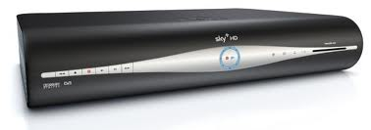
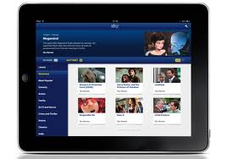
The Data Landscape – Data available at ‘Platform’ level
3rd Party Data
Broadcast Viewing Data
PVR Viewing Data
On-Demand Viewing Data
Customer Account Information
Advertiser Data
INTERNET
BARB Data
Individual Viewer Profiles
Broadcast Schedule Data
Second Screen Activity
Advertising Schedule Data

Slide 8
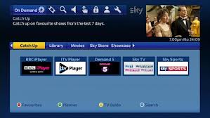
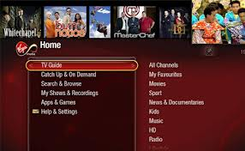
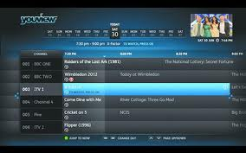
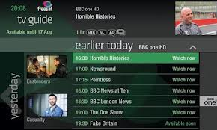
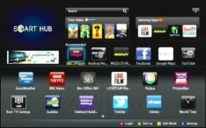
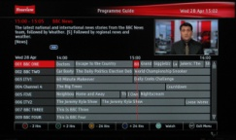
Platform VOD vs Federated Player VOD
BSkyB Virgin BTYouView TalkTalk Youview Freesat SmartTV Freeview
Yes
SkyiQ
Yes
Partial
Partial
Area of Need
Consumer Data
Whole Home
Data Crunching
Personalised TV
AdInsertion
Yes
AdSmart
Yes
VOD insertion
??
??
Yes
Yes
??
??
Yes
Yes
Area of Need
Yes
Yes
Channels

Slide 9
Data – the Key Questions
Can you:
Correlate usage across linear and VOD for a single channel?
Correlate linear and VOD use across different channels?
Identify different users within a household?
Correlate personal use in household with group use?

Slide 10
@nwalley
@DecipherOffAir
Nigel Walley
Managing Director – Decipher Group
nigel.walley@decipher.co.uk
02087474592
End

